Slide 1
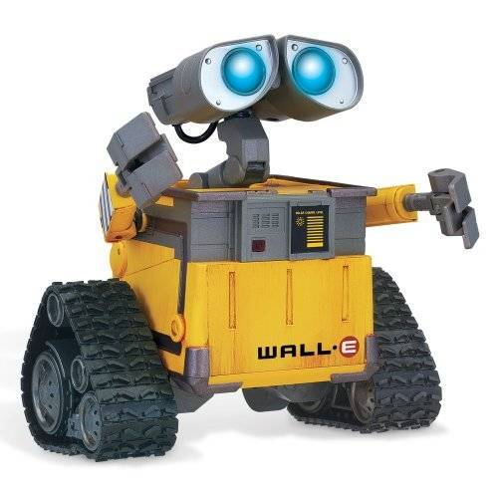


The Wait-Until-Event pattern
Has it happened?
Has it happened?
Has it happened?
Has it happened?
Yes, it happened!

Slide 2
The Definite Loop pattern
for k in range(...):
...
...
window = zg.GraphWin('Animation', 650, 430)
x = 20
y = 50
radius = 5
for k in range(150):
circle = zg.Circle(zg.Point(x, y), radius)
circle.setFill('purple')
circle.draw(window)
x = x + 2
y = y + 1
radius = radius + k / 100
time.sleep(0.01)
Determines how many times the loop iterates
The body of the loop

Slide 3

The Definite Loop pattern
for k in range(...):
...
...
window = zg.GraphWin('Animation', 650, 430)
x = 20
y = 50
radius = 5
for k in range(150):
circle = zg.Circle(zg.Point(x, y), radius)
circle.setFill('purple')
circle.draw(window)
x = x + 2
y = y + 1
radius = radius + k / 100
time.sleep(0.01)

Slide 4
The Definite Loop pattern
The Wait-Until-Event pattern
Repeatedly:
...
Has the event occurred?
If so, break out of the loop.
...
Run n times:
...
...

Slide 5

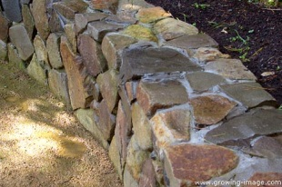
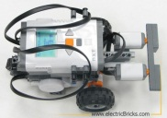
The Wait-Until-Event pattern
Repeatedly:
...
Has the event of interest occurred?
If so, break out of the loop.
...
Repeatedly:
x = something input from the user
if x is the “sentinel” value:
break out of the loop
Process x.
Robot: Start moving.
Repeatedly:
Robot: Have you bumped into anything?
If so, break out of the loop.
Robot: Stop.
463
814
22
-1

Slide 6
The Wait-Until-Event pattern
Expressed in Python using while True and break
while True:
...
if the event of interest occurred:
break
...
robot.go(..., 0)
while True:
sensor = 'BUMPS_AND_WHEEL_DROPS'
bump = robot.getSensor(sensor)
if bump[3] == 1 or bump[4] == 1:
break
robot.stop()
while True:
msg = 'Enter int, or -1 to stop'
x = int(input(msg))
if x == -1:
break
Process x.

Slide 7
The Definite Loop
pattern
for k in range(...):
...
...
Do the following 150 times:
Draw a circle.
Move and grow the circle.
The
Wait-Until-Event pattern
while True:
...
if the event of interest occurred:
break
...
Repeatedly draw, move and grow a circle, stopping when the circle grows beyond the border of the window.
Do blah until the user asks you to stop.
Robot, go until you hit a wall.
Robot, go until your sensors say that you have gone 10 centimeters.

Slide 8
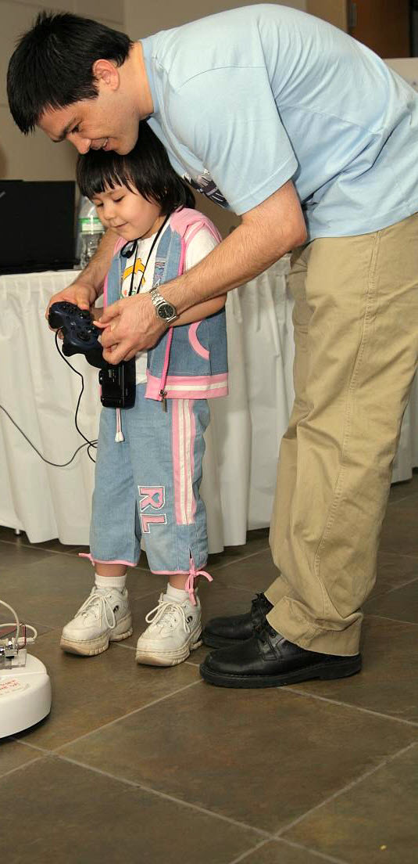
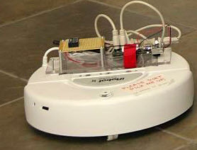
The Wait-Until-Event pattern
while True:
...
if the event of interest occurred:
break
...
Repeatedly draw, move and grow a circle, stopping when the circle grows beyond the border of the window.
Do blah until the user asks you to stop.
Robot, go until you hit a wall.
Robot, go until your sensors say that you have gone 10 centimeters.

